Slide 1

Systems programming
9 – Concurrency and parallelism
MEEC LEEC MEAer LEAer MEIC-A
João Nuno Silva

Slide 2
Bibliography
Time-Sharing Computer Systems, John McCarthy, MIT, 1964
McCarthy, John, et al. "THOR: a display based time sharing system.", Proceedings of the April 18-20, 1967, spring joint computer conference. 1967.
Bauer, Walter F. "Computer design from the programmer's viewpoint.", Papers and discussions presented at the December 3-5, 1958, eastern joint computer conference: Modern computers: objectives, designs, applications. 1958.
Concurrent Programming for Scalable Web Architectures, Benjamin Erb, Section 2.3
Principles of Concurrent Programming, M. Ben-Ari, Chapter 1
Operating Systems – design and Implementation, Section 2.4

Slide 3
Why Concurrency
So far most or all of your study in computing has assumed
  One thing happened at a time
Called sequential programming
  everything part of one sequence

Slide 4
Concurrency
Concurrency
  Execution of two or more tasks overlap in time
  Purpose
    decrease response time
  mechanism:
    switch between different threads of control
    work on one thread when it can make useful progress; when it can't, suspend it and work on another thread

Slide 5
Concurrency
In the real world different activities often proceed at the same time .
  But inter-related (one activity affect the others)
  They are concurrent
Computers are concurrent
  Multiple resources
    dozen processors, 10 disks, and 4 network interfaces; I/O devices
    screen, keyboard, mouse, camera, microphone, speaker, network interface
  Multiple users/applications

Slide 6
Concurrency
Relevant to the programmer
  Network services need to be able to handle multiple requests from their client
  Most applications today have user interfaces while simultaneously executing application logic
  Parallel programs need to be able to map work onto multiple processors
  Need to mask the latency of disk and network operations

Slide 7
First computers
Batch processing computers
  First computers
  Slow, one task at the time
  Transistors, magnetic core memory
1945 – ENIAC
  18000 vacuum tubes
  7200 crystal diodes
  1,500 relays
  70,000 resistors
  10,000 capacitors,
  150 kW, 27 t
  100 word memory, 5000 SUMs per second
1957 - IBM 709
  100 kW, 1 Ton
  32K words memory, 42000 SUMs per second

Slide 8
Time sharing WF Bauer (1958)
Laboratory computer
  sequential operations + slow data access
Buffered compute
  sequential operations + fast data access
Automatic computer
  Operations + concurrent data access
Parallel system
  current operation of large components
Self organizing System
  Periodically examine its own operations and auto matically take certain steps to change its function.

Slide 9
Time sharing WF Bauer (1958)
The central idea here is that each large metropolitan area would have one or more of these super computers.
The computers would handle a number of problems concurrently.
  Input-output equipment installed on their own premises
  would buy time on the computer
    the same way we buy power and water from utility companies.
Tasks are scheduled by a supervisor
  Each work has a priority

Slide 10
Time sharing John McCarthy (1964)
I should like to go on now to consider how the private computer can be achieved.
  It is done by time sharing a large computer.
  Each user has a console that is connected to the computer by a wired channel such as a telephone line.
  The consoles are two kinds,
    one cheap and the other better but more expensive (the cheap console is simply an electric typewriter that is use for both input and output.
    The more expensive console can include a cnathode-ray-tube unit on which the computer can display pictures and text

Slide 11
Time sharing John McCarthy (1964)
Operation of such a system as it appears to the user of the typewriter console.
  When the user wants service, he simply starts typing in a message requesting the service.
  The computer is always ready to pay attention to any key that he may strike, just as the telephone system is always ready for youu to lift the receiver of the hook.
  As soon as the key is depressed on the typewriter, a signal is sent to the computer.
  The effect of the signal is to make the computer interrupt the pro after the current instruction has been executed and jump temporarily to a program that determines what the typewriter wants.

Slide 12
Time sharing John McCarthy (1964)
At any moment some of the typewriters
  will be inactive
  some will be in the middle of entering messages into the computer,
  some will be in the process of typing out characters
  some will be in a status of wanting programs run.
This is one example of a time-sharing system.
  There are a large number of users.
  Each user has his own console, gets service from the computer whenever he desires it, and has the computer maintain his files for him.

Slide 13
Time sharing Requirements
Large primary memory
Interruption system to handle errors as well as input and output
Completely nonstop operation
Erroneous programs must be prevented from damaging other programs
  it must interrupt if the program attempts any memory references outside its allotted region,
  programs that get into endless loops must be prevented from wasting computer time.
Advances memory management (relocation/virtual)
Secondary storage enough to maintain users’ files.

Slide 14
Time-sharing application
BBN time-sharing system
  increase the effectiveness of the PDP-1 computer
  for applications involving man-machine interaction
Allowing the five users
  each at his own typewriter to interact with the computer
  just as if he had a computer all to himself.
1966 - Thor on PDP-1
  8K Words
  22x4Kw drum memory
  5 users programs
  Each user
    Sees 4kwords
    Response < 1s

Slide 15
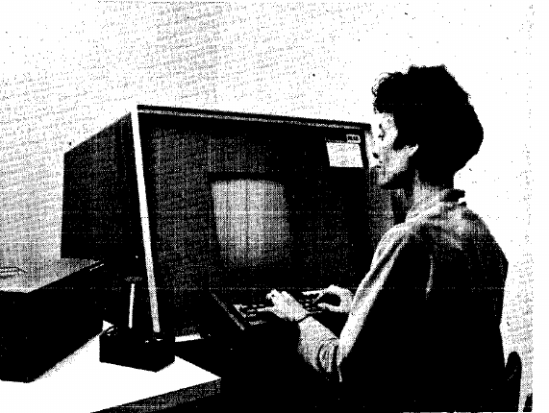
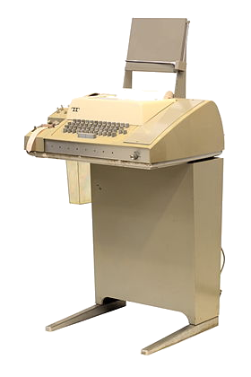
Time-sharing application
THOR 1966
  Control computer based
  teaching laboratories
  Text editing
  General purpose programming
  Better interaction CRT vs teletype
  Understand trade-offs
PDP-1
  4K Words
  US$ 120K
  20 user programs
  28 consoles

Slide 16
Time sharing Computers
Time-sharing Computers
  Multiple users
  Single CPU
  Transistors
1966 - Thor on PDP-1
  4K Words
  US$120K
IBM 7090 (Super IBM 709)
  6x faster 3x cheaper
1964 - IBM S/360 Model 67
  512 Kbyte
1966 – DEC PDP-7
  4K words

Slide 17
Computer history
Multitasking/Interactive Operating Systems
  multiple-programs
  Single CPU
  Word and excel running at the same time
Multiple tasks inside the same program
  Excel, loading a file while updating a table

Slide 18
Concurrency
Doing many things during the same interval
  Not necessary at the same time
Solve/run multiple units of tasks
  with a single shared resource
  during a period of time
On computers, time and CPU are shared
  At one instance only one task is executing in the CPU
Gives the user
  The illusion of parallelism

Slide 19
Concurrency
In the real world different activities happen at the same time
  Are inter-related (one activity affect the others)
  Are concurrent
Computers are concurrent
  Multiple shared resources
    Processors used by various programs
    Disks being accessed by various programs
    Network interfaces being used by various programs
  Multiple users/applications

Slide 20
Concurrency
Relevant to the programmer
  Network services need to handle multiple requests
  Most applications today have user interfaces while simultaneously executing application logic
  Allows masking the latency of disk and network
Concurrent programs automatically become parallel
  If multiple processors exists

Slide 22
What comes after Concurrency?
On our desktop….
From roughly 1980-2005 desktop computers
  got exponentially faster at running sequential programs
  About twice as fast every couple years
But nobody knows how to continue this
  Increasing clock rate generates too much heat
  Relative cost of memory access is too high

Slide 23
What comes after Concurrency?
But transistors were getting smaller
But we can not keep making “wires exponentially smaller”
  Moore’s “Law”
so put multiple processors on the same chip
  “multi-core”

Slide 24
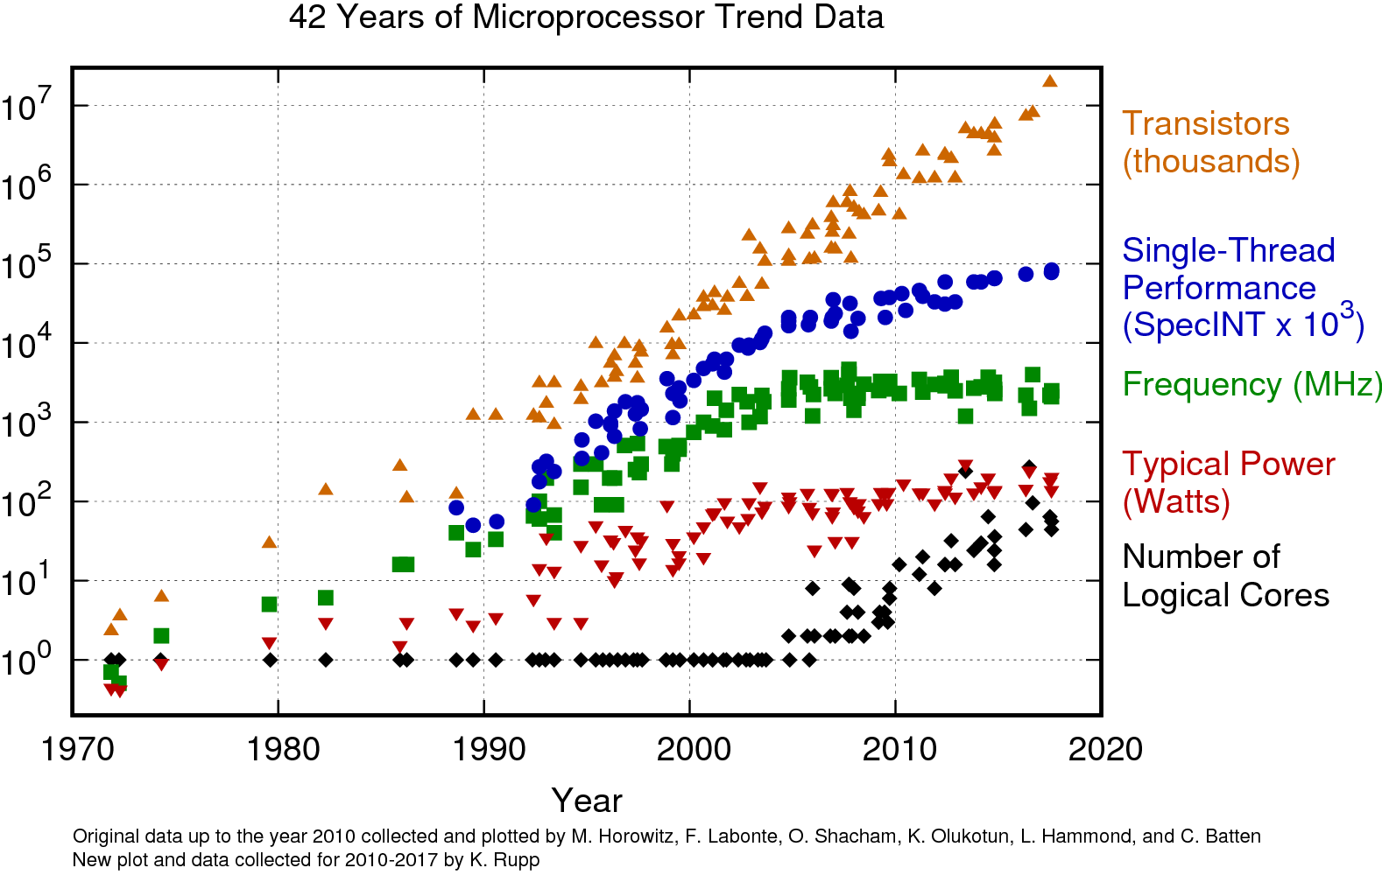
What comes after Concurrency?
https://www.karlrupp.net/blog/
Plateau of frequency
More transistors inside each chips
More cores inside each chip

Slide 25
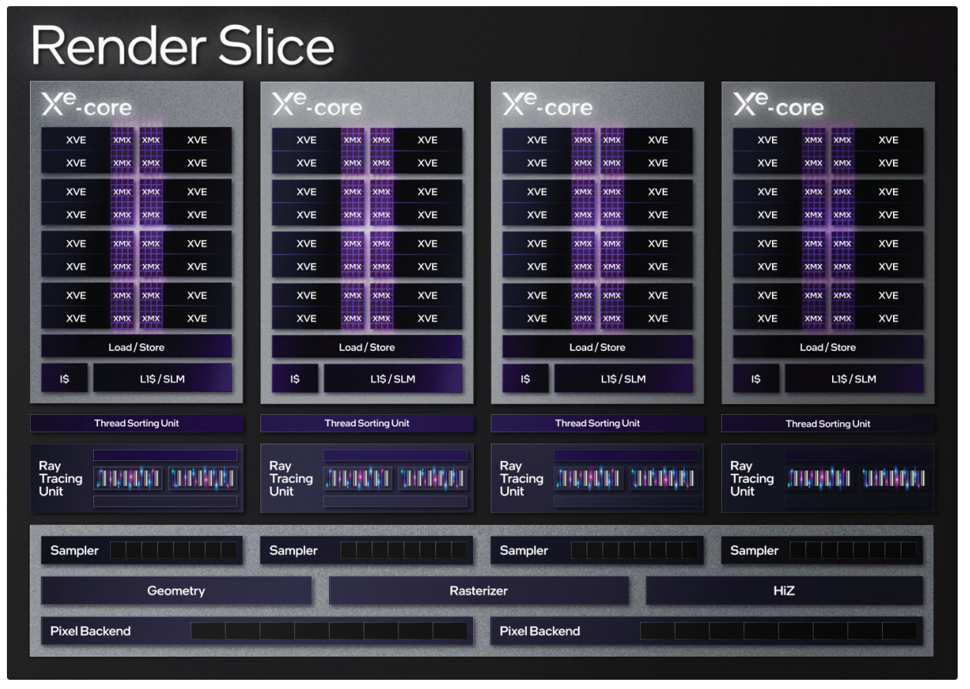
... we get to parallelism
All computers have 4 / 8/16/... processors
  Wait a few years and it will be 32, 64, 128
  The chip companies have decided to do this not a “law”
We have GPUs...
  Intel Arc A380 $139
    8 Xe core
    1024 GPU Cores
    128 MXM Engines

Slide 26
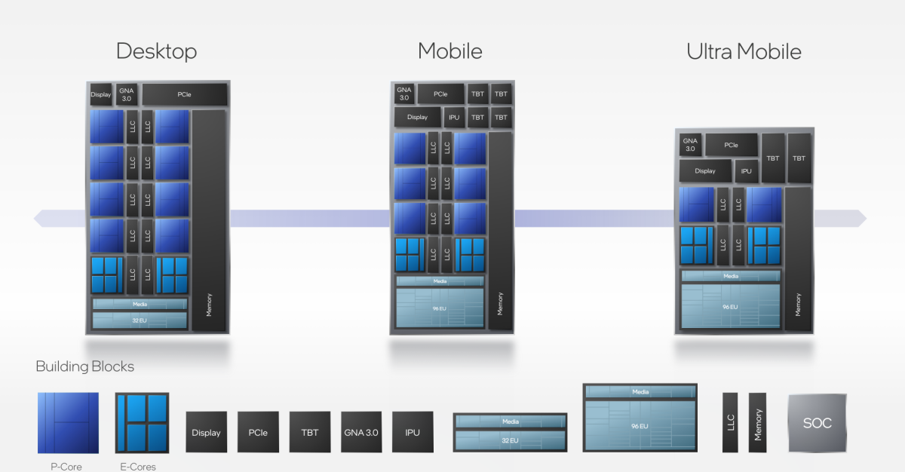
... we get to parallelism
Intel - P-CORES and E-CORES

Slide 27
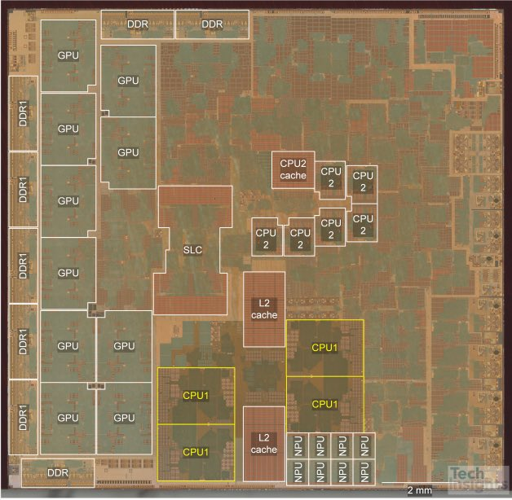
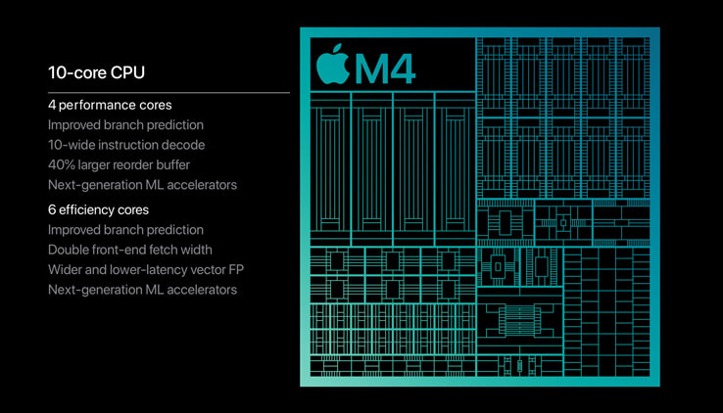
... we get to parallelism
Apple

Slide 28
Parallel computers
What can you do with them?
  Run multiple totally different programs at the same time
    Already do that? Yes, but with time-sharing
Do multiple things at once in one program
  Requires rethinking everything
    from asymptotic complexity
    to how to implement data-structure operations
Split complex tasks into simpler independent ones

Slide 29
Parallelism
Doing many things at the same time instead of sequentially
Simultaneously
  Requires multiple processing units

Slide 30
Parallelism vs. Concurrency
Concurrency:
  Correctly and efficiently manage simultaneous access to shared resources
Parallelism:
  Use various independent resources to solve a problem faster
requests
work
resources
There is some connection:
  Both use threads
If parallel computations need access to shared resources
  then the concurrency needs to be managed
resource

Slide 31
Parallelism vs. Concurrency
Perform many tasks simultaneously
Purpose
  improves throughput
Mechanism:
  many independent computing devices
Decrease run time of program by utilizing multiple cores or computers
  running your web crawler on a cluster versus one machine.

Slide 32
Parallelism vs Concurrency
In each instance only one tasks is running
Purpose
  decrease response time
Only uses one core or computers
  But user thinks various cores are being used simultaneous

Slide 33
Parallelism vs Concurrency
Mechanism:
  switch between different tasks
  work on one task when it can make useful progress
  suspend one task and work on another thread
Running the excel, chat and music player at the same time on a single CPU.
  OS gives each of these programs a small time-slice (~10msec)
Allow a program to continue execution
  while waiting for I/O device to respond,
  letting another thread do useful CPU computation

Slide 34
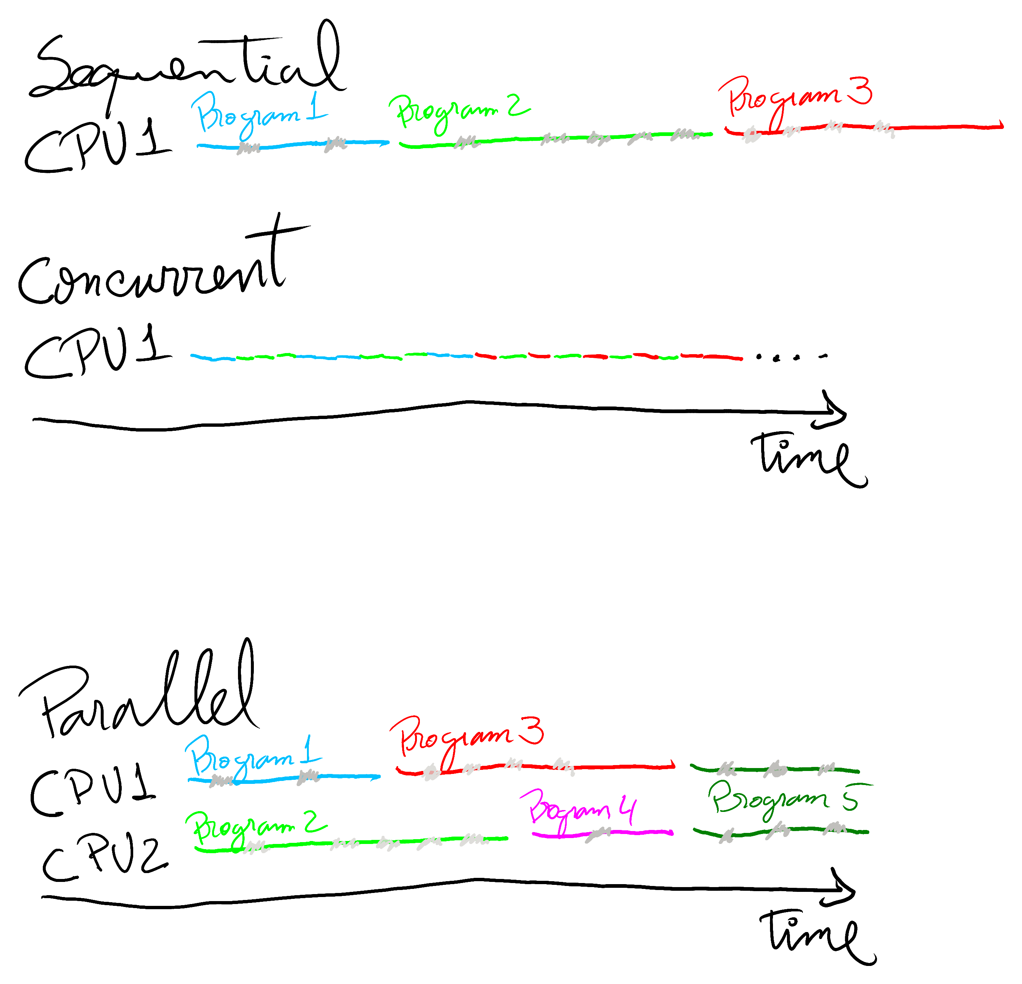
Concurrency

Slide 35
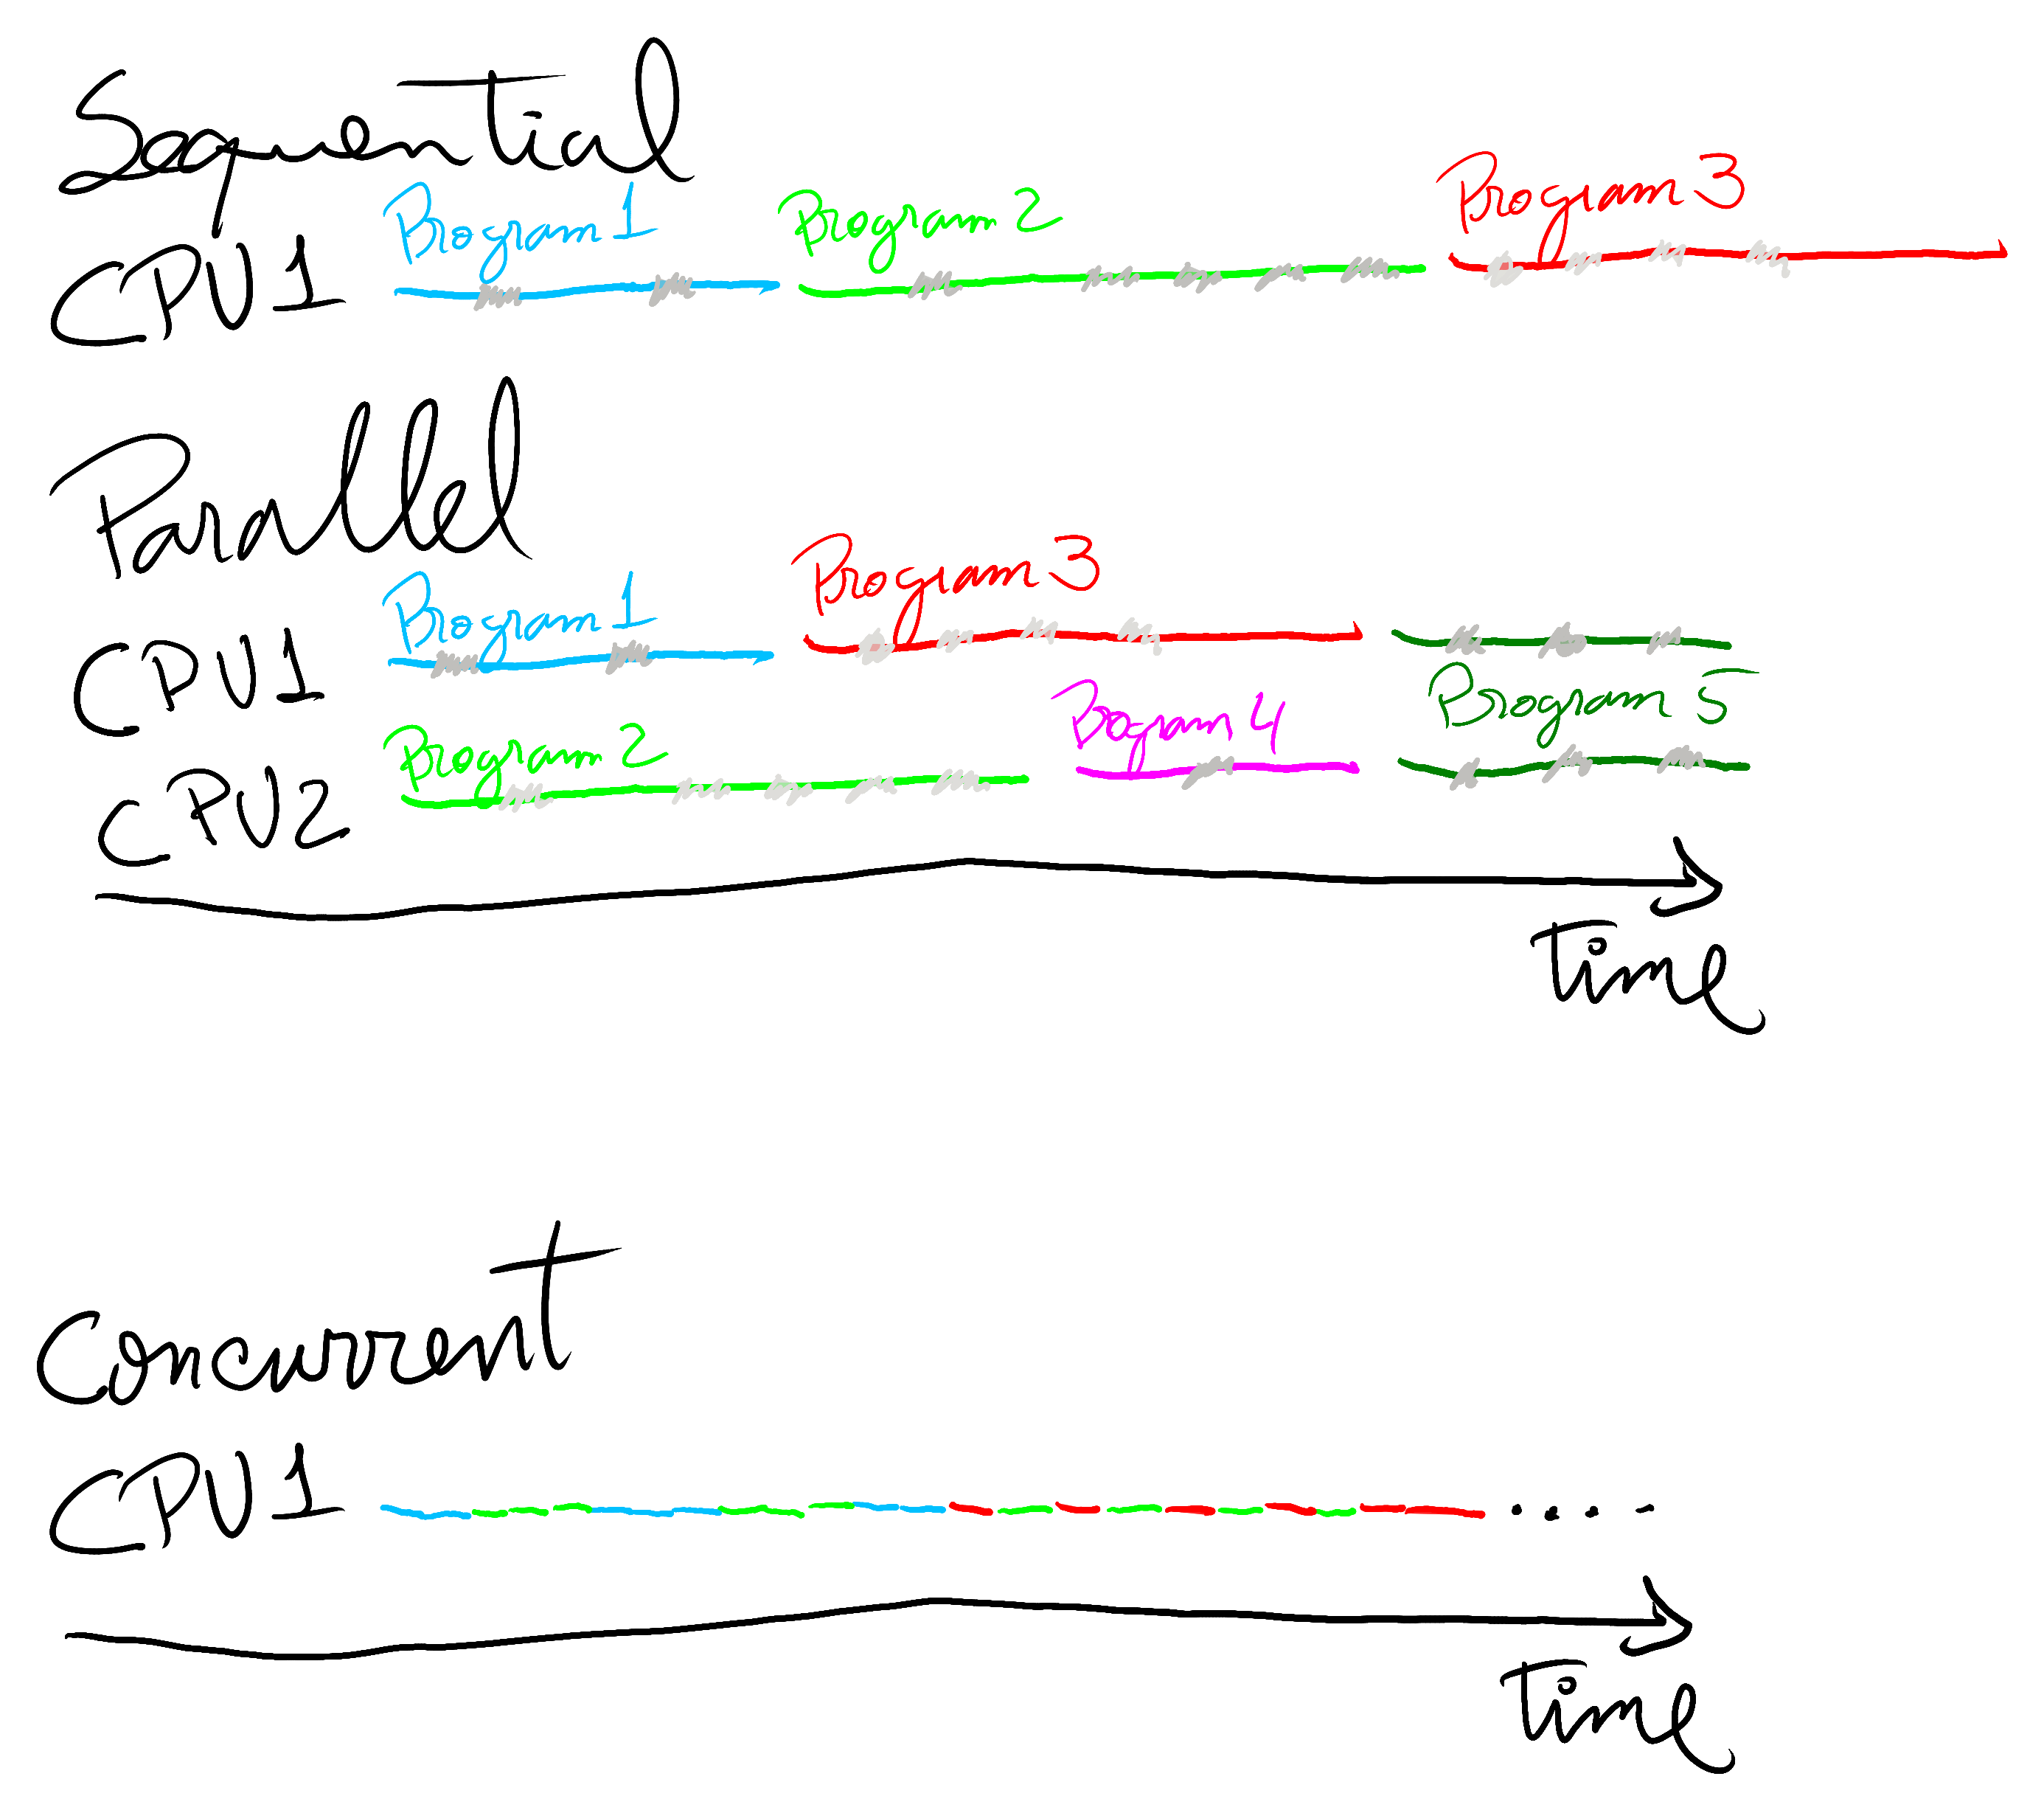
Parallelism

Slide 36
Concurrency without parallelism
1CPU, 1 RAM, 1 I/O
  While one tasks waits for a device
    Network I/O, Disk I/O, GPU, ...
  Other task can be scheduled to use the CPU
  When data is available on the device
    Tasks are switched
Shared resource between tasks
  CPU or variables

Slide 37
Parallelism without concurrency
Multiple CPUs/Computers
  Without sharing resources

Slide 38
Concurrency with parallelism
PC
  One vs multiple users
  One vs multiple programs
  One vs multiple CPU
Kitchen
  One vs multiple cooks
  One vs multiple knifes
  One vs multiple recipes

Slide 39
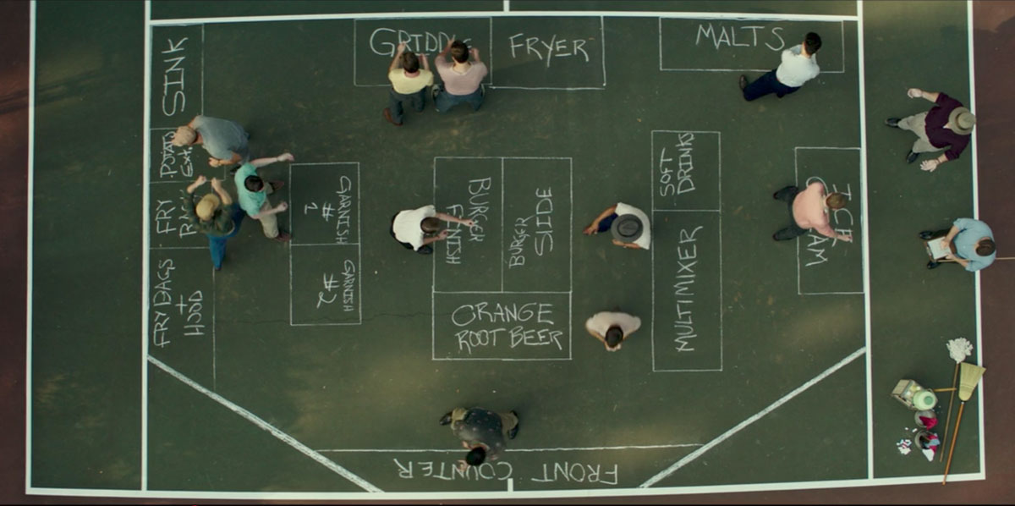
Concurrency with parallelism

Slide 40
Types of parallelism
Data Parallelism
  same computation being performed on a lot of data
Task Parallelism
  different computations/programs running at the same time
Pipeline Parallelism
  assembly line:

Slide 41
Types of concurrency
Instruction level
  the execution of two or more machine instructions simultaneously
Statement level
  execution of two or more statements simultaneously
Unit level
  execution of two or more subprogram units simultaneously
Program level
  execution of two or more programs simultaneously

Slide 42
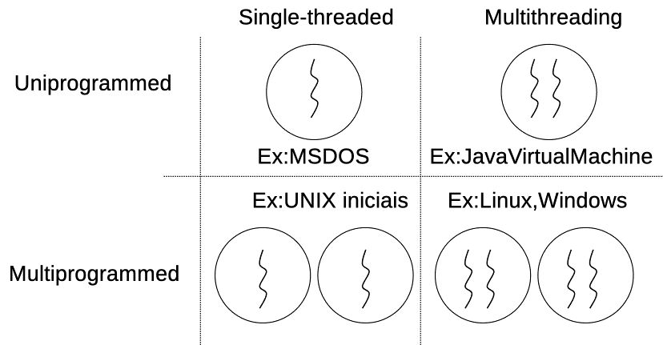
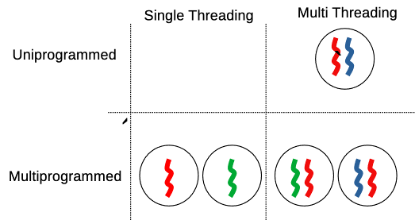
Concurrency / parallelism in OS
Processes / Threads
Single CPU / Multiple CPU

Slide 43
Scheduler
Selection of the process/task to execute
Guarantees
  Fairness - Every process gets its fair share
  Efficiency - Keep CPU busy 100%
  Response time – for interactive processes
  Turnaround – for batch processes
  Throughput – maximize results

Slide 44
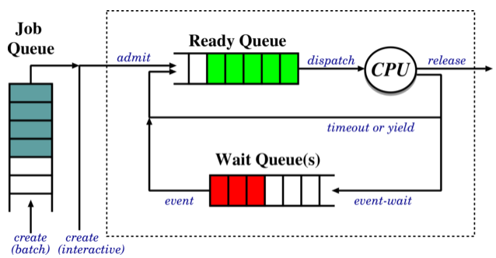
Scheduling concepts
Queues
  necessary to store information about tasks/processes
  Job Queue
    processes awaiting admission
  Ready Queue
    processes in main memory,
      ready and waiting to execute
  Wait Queue(s)
    processes waiting for an IO device (or for other processes)

Slide 45
Scheduling concepts
Job scheduler
  selects processes to put onto the ready queue
CPU scheduler
  selects process to execute next and allocates CPU

Slide 46
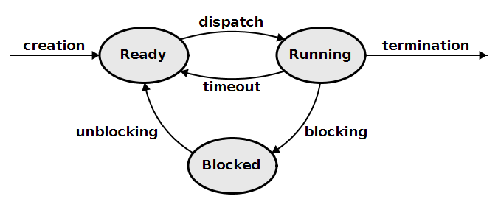
Preemptive vs Non preemptive
When to select the next process to run on the CPU?
Non-preemptive
  Running → blocked
  Running → exit
Pre-emptive
  Runing → ready
  Blocked → ready

Slide 47
Non preemptive
Simple to implement
  No timers, process gets the CPU for as long as desired
Open to denial-of-service:
  Malicious or buggy process can refuse to yield
Typically includes an explicit yield call
  Allow the programmer to release the CPU
Include implicit yields
  performing IO, waiting
Examples: MS-DOS, Windows 3.11

Slide 48
Preemptive
Solves denial-of-service:
  OS can simply preempt long-running process
More complex to implement:
  Timer management, concurrency issues
Implemented in modern OS

Slide 49
Scheduling Algoritms
Round Robin
Priority (static and dynamic)
Shortest Job first
Guaranteed Scheduling
Earliest deadline first

